Slide 1
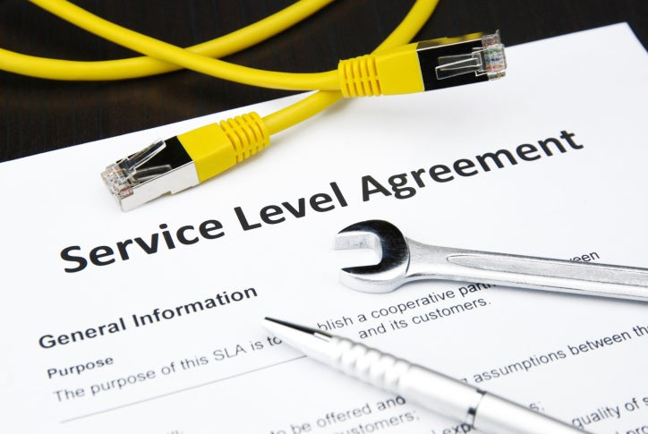
Lec 6
Sla Contd
Demonstration of Web Deployment on Azure linux Enviornment
Enabling Desktop / RDP on Ubuntu LTS Server

Slide 2
why you should create service-level agreements?

Slide 3
why you should create service-level agreements
Ever ordered pizza from a particular restaurant because they guaranteed your food would be delivered in 30 minutes or less?
Then you already understand the appeal of a robust service-level agreement (SLA).
Sure, most SLAs are printed on contracts rather than on takeout menus.
But the basic premise remains the same—it’s a promise to provide a baseline level of service.

Slide 4
Sure, most SLAs are printed on contracts rather than on takeout menus.
You don’t know exactly how soon your pizza will arrive, but it’s guaranteed to get there before the game starts.
Your marketing team probably shouldn’t promise people a free pizza in SLA, but making other types of guarantees could really pay off.
The SLAs help define your team’s goals and establish your company’s reputation

Slide 5
SLAs are an integral part of an IT vendor contract
An SLA pulls together information on all of the contracted services and their agreed-upon expected reliability into a single document
They clearly state metrics, responsibilities and expectations so that, in the event of issues with the service, neither party can plead ignorance
It ensures both sides have the same understanding of requirements
Any significant contract without an associated SLA is open to deliberate or inadvertent misinterpretation
The SLA protects both parties in the agreement

Slide 6
Types of SLA
Corporate Level SLA
Customer Level SLA
Service Level SLA
Internal SLA
external SLA

Slide 7
Corporate Level SLA
A business agreement with an organization and service provider
All of the general issues relevant to the organization are covered, and they are the same throughout the entire organization.
For example, with security SLA at the organization level, every employee needs to create passwords of 8 characters and must change them every thirty days

Slide 8
Customer Level SLA
A business agreement with an individual client or group that sets a specific standard
For example
Security requirements of one or more departments within the organization are higher, the financial department needs more top security measures by virtue of its crucial role and handling of financial resources.

Slide 9
Service Level SLA
Specific standard for support that’s promised to all customers who are using a particular service or product.
If the telecom company guarantees a specific uptime to all clients or offers a free routine service to every customer, that would be a service-based SLA.

Slide 10
Internal SLA
An internal SLA could be an agreement between multiple departments within your organization.
Internal SLAs could simply be standards that you set as objectives for your organization but don’t formally guarantee to clients.
For example, you might set a company goal for initial replies or resolution times.
If your team hits the target, then you can start promising customers a specific response rate. (Note that it’s always a good idea to privately test all proposed SLAs before taking them public)

Slide 11
External SLA
External SLAs are used between a service provider and its customers.
It states the expected services and other requirements for the business relationship

Slide 12
SLA Example
Say we are a beverages provider, with tea, coffee, and juices in our service portfolio
If customer A wants the tea to be provided every morning and evening, coffee before and after lunch, and juices during lunch hours, that’s the customer-specific SLA we have signed with that particular customer, and that’s how we price the offering
On the other hand, if we also have a stand where we offer juices throughout the day but at fixed prices and where customers B and C can source their needs, this is a service-based SLA

Slide 13
An SLA document typically consists of:
An introduction to the SLA, what does this agreement propose
A Service description, what service this SLA supports, and details of the service
Mutual responsibilities, who’s responsible for what part of the service
Applicable service hours, from what time till what time is the service available according to the agreement
Service availability, how much is the service available during the service window and outside of the service window
Reliability
Customer support arrangements
Service performance
Security
Costs and charging method used

Slide 14
5 Things to Look For in a Cloud Service Level Agreement
Availability
Data ownership
Cloud hardware and software
Disaster recovery and backup
Customer responsibilities

Slide 15
Availability
The biggest quality-of-service (QoS) concept that should be covered in any Cloud SLA is the provider’s promised availability
Providers might break down availability depending on time frame
– for example, they might promise 99.99% availability during business hours
These terms should also include the provider’s plan for unexpected downtime, including alerting its users and providing updates on maintenance and service repairs.

Slide 16
Data ownership
Who owns your data in the cloud?
That question prevents many enterprises from making the jump to the cloud, especially when they consider sensitive data
An SLA should specifically outline its data ownership policies so that everything is transparent and clear
Ideally, an SLA should state that all ownership rights stick with the user
However, if the provider doesn’t explicitly state its data ownership policies in the SLA, you can’t guarantee the safety of your information.

Slide 17
Cloud hardware and software
Your cloud provider requires the use of hardware and (potentially) software to operate its services
The provider should outline the hardware that the cloud services rely on, including servers and other devices
Knowing your cloud’s equipment and software specifications will help you understand the specifics behind your cloud environment’s construction and what you’ll need to educate your staff on

Slide 18
Disaster recovery and backup
In the event of a disaster, your cloud provider should have a plan in place to prevent total loss of your data
Cloud providers should have a section of the SLA that describes their disaster recovery and backup solutions in detail
Depending on the provider, they may provide automatic backups and snapshots of your data
If the user is required to set up backup and recovery systems, the SLA should outline that
It may not specifically state how to activate them, but you should be aware if you need to activate them or not.

Slide 19
Customer responsibilities
The SLA is a contract that outlines responsibilities that both the provider and customer agree to
Your cloud provider needs to inform you of what you’re liable for when you enter the agreement
Make sure you consider over the entirety of the SLA to know what your provider will manage and what you need to as a customer

Slide 20
How often should we revise our SLAs?
Most SLAs are negotiated to meet the customer's current needs, but many businesses change dramatically in size over time
A solid cloud service-level agreement outlines intervals where the contract is reviewed and potentially adjusted to meet an organization's changing needs.
Some vendors build in notification workflows that trigger when a cloud service-level agreement is close to being breached, so new negotiations can be initiated based on the changes in scale. This can cover uptime availability levels or usage that exceeds criteria and might warrant an upgrade to a new service tier

Slide 21
Cloud SLA examples
SLA summary for AWS
https://aws.amazon.com/legal/service-level-agreements/
SLA summary for Azure services
https://azure.microsoft.com/en-us/support/legal/sla/summary/
SLA summary for Google Cloud
https://cloud.google.com/terms/sla

Slide 22
Demonstration of Web Deployment on Microsoft Azure

Slide 23
Enabling Desktop , RDP on Linux LTS Server
First update system
sudo apt-get update
Then install UI XFCE4
sudo apt-get install xfce4
Afterwards install XRDP - remote desktop
sudo apt-get install xrdp
Then register xrdp in xfce4
echo xfce4-session ＞ ~/.xsession
Finally restart XRDP
sudo service xrdp restart

Slide 24
OR
sudo apt install ubuntu-desktop –y (Latest GUI)
sudo apt-get -y install xrdp (Install Remote Desktop)
sudo systemctl enable xrdp (Enable Remote Desktop)

